Slide 1

Password Management with Security
Presented By:
Sudarsanaa Mathan 23CSR217
Santheesh S 23CSR193
Tharaneesh Rajan N 23CSR227

Slide 2

Password Management
Password management refers to the process of securely creating, storing, organizing, and maintaining passwords to protect user accounts and sensitive information from unauthorized access.
It involves implementing best practices, tools, and security measures to ensure that passwords remain strong, unique, and protected from cyber threats.
It Deals with:
Password Creation:
Password Storage
Password Recovery & Management Policies

Slide 3
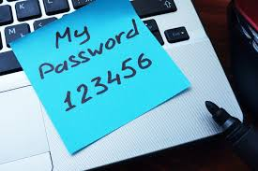
The Problem Statement
Users struggle to remember multiple complex passwords
Many people reuse passwords across different accounts, increasing security risks
Writing down passwords or saving them in unprotected files leads to potential leaks
Cyberattacks, such as brute force attacks and phishing, exploit poor password management.
Solution:
Use Password Managers:
Enable Multi-Factor Authentication (MFA):
Regularly Update Passwords
Check for Data Breaches

Slide 4
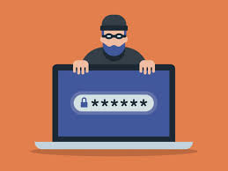
Types Of Risks
Without proper password management, users and organizations are exposed to several security threats as follows:
Brute Force Attacks: Hackers use automated tools to guess passwords by trying multiple combinations
Credential Stuffing: Attackers use stolen passwords from one data breach to access multiple accounts.
Phishing Attacks: Cybercriminals trick users into revealing passwords through fake websites or emails.
Data Breaches: Weak or compromised passwords can lead to massive data leaks.
Account Takeover and Identity Theft: Unauthorized access to personal accounts can lead to fraud and misuse of sensitive data.

Slide 5

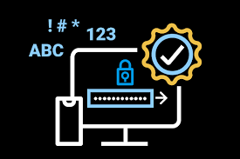
Features
Secure Storage : Encrypts and securely stores passwords.
Master Password : One password to access all stored credentials
Auto-Fill & Retrieve : Easily fetch saved passwords.
Password Generator : Creates strong, unique passwords.
Cross-Platform : Works on multiple devices.
Zero-Knowledge Encryption : Only you can access your data
Import/Export : Backup and restore passwords easily.

Slide 6
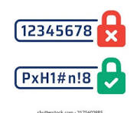
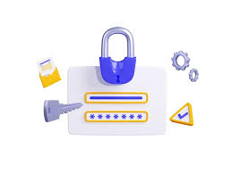
S
Characteristics of a Strong Password
A strong password should have:
Length: At least 12-16 characters.
Complexity: Mix of uppercase, lowercase, numbers, and special characters.
Uniqueness: Shouldn’t be used across multiple accounts.
Unpredictability: Avoid common words, birthdays, and names.

Slide 7

S
WorkFlow
Planning & Design
Define core features (local storage, master password, auto-logout, etc.)
Frontend Development
Implement JavaScript for form handling:Toggle between login, signup, and password sections.
Backend & Data Handling
Decide whether to use local storage (client-side) or a secure backend (server-side).
Testing & Debugging
Test with various inputs (short/long passwords, invalid formats, etc.).
Features & Optimization
Implement password generator.
Add import/export options (JSON or CSV format).
Security Enhancements
Encryption: Ensure passwords are stored and retrieved securely.

Slide 8
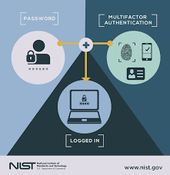
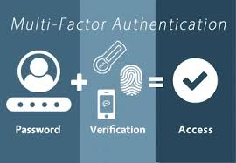
S
Multi-Factor Authentication
Instead of just a password, MFA combines two or more of the following factors:
Something You Know – Password, PIN, security question.
Something You Have – OTP via SMS, authentication app, security token.
Something You Are – Fingerprint, facial recognition, retina scan.

Slide 9
S
Uniqueness
Full User Control (No Cloud Storage)
Unlike popular password managers that store data on their servers, your system can operate locally on the user's device.
Zero-Knowledge Security Model
can use true end-to-end encryption, where only the user knows the master key.
No Subscription Fees / Hidden Costs
LastPass, Dashlane, and 1Password charge subscription fees for premium features
Lightweight and Fast
Many well-known managers come with bloated features and browser extensions that slow down performance
Custom Security Features
Self-destructing passwords after a certain time.
Auto-logout on inactivity to prevent unauthorized access.

Slide 10
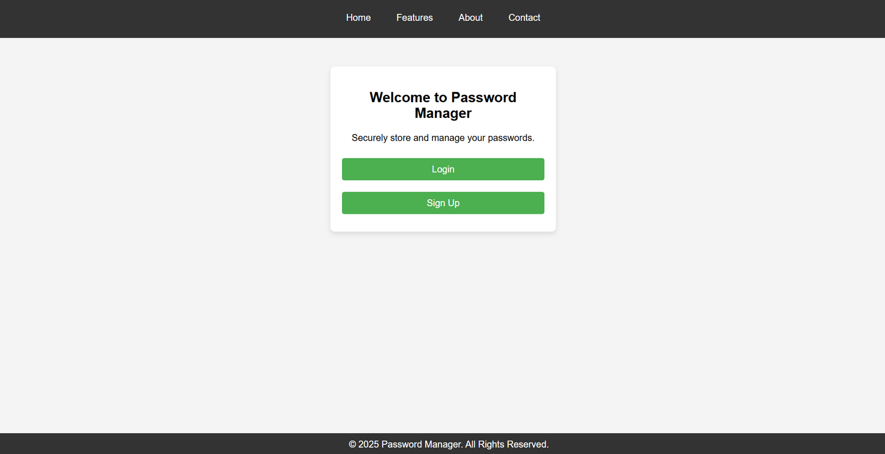
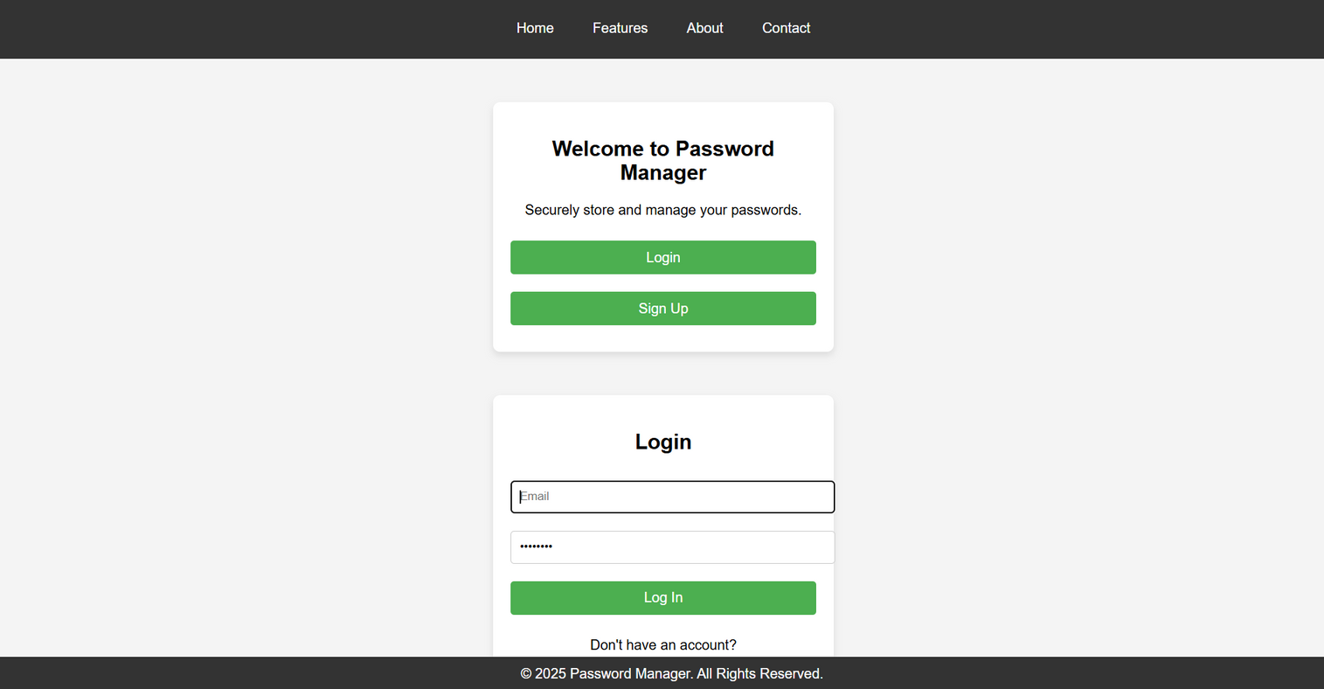
Password Manager
The Home Page

Slide 11
THANK YOU

